Slide 1







Shield

Slide 2
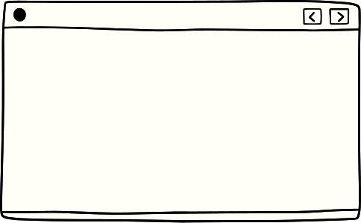

Lack of Collaboration
Americans lack trust
Time-difference
Lack of delegation of work
No liaison between teams
Cross-cultural communication barriers
This led to…
Both teams working on same modules
Decrease in respect for other team
Decrease in motivation/commitment

Slide 3

Lack of Motivation/Commitment
“Moved to another project that gives me responsibility… I was with Shield for two years. I wasn’t getting my growth.”
“I feel I’m not properly utilized.”
“You get a doubt: why do they need us?”
“I’m not directly contributing to the product.”
Individual Performance
Organizational Rewards
Instrumentality
Organizational Rewards
Personal
Goals
Valence

Slide 4




Reinforcement Theory
Reinforcement conditions behavior.
The consequence following the behavior impacts the likelihood that it will happen again.
Research Supporting Our Solution
Methods to Increase Cohesiveness
Encourage agreement with group goals.
Increase the time members spend together.
Give rewards to the group rather than to individual members.
.

Slide 5
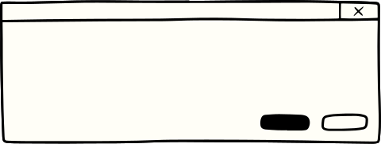

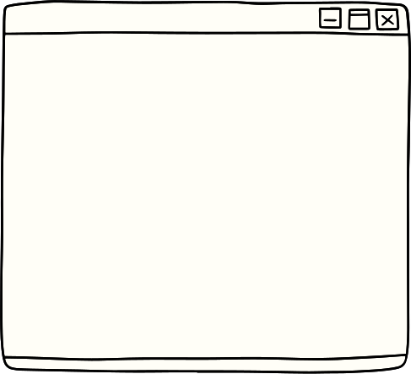


The Vision
Create Understanding
Articulate
the Value
Create Structure
Notes:
Malee & Anjana

Slide 6
Thank you! Questions?
Notes:
Malee & Anjana

